Slide 1

Competitive Programming From Problem 2 Solution in O(1)
P
T
H
I
N
K
F
A
S
T
S
C++: More on Output & Input
Mostafa Saad Ibrahim
Teaching Assistant @ Cairo University

Slide 2
We already print!
But..
Sometimes we need more advanced tricks in displaying data
Let’s start with a simple one..setw
Setw(n) = Set the field width to n.
Display next item in n cells

Slide 3
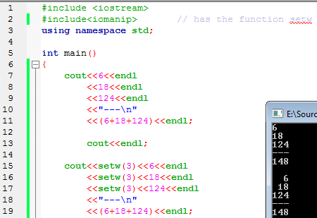
Display summed numbers aligned

Slide 4
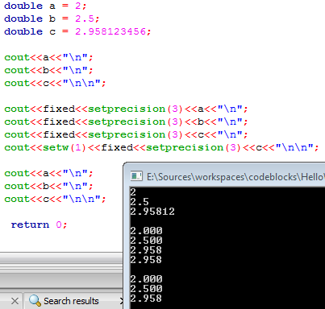
Fixed+setprecision

Slide 5
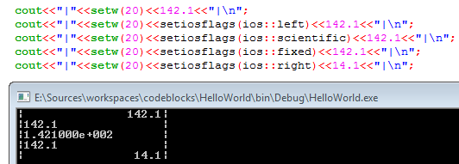
setiosflags

Slide 6
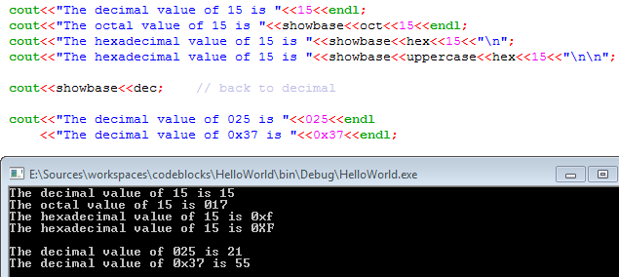
Bases Conversions

Slide 7
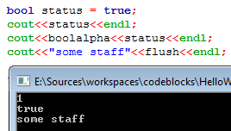
Others

Slide 8
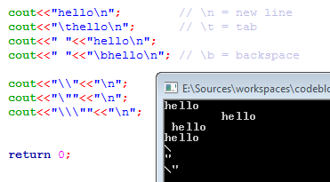
Escape Characters

Slide 9
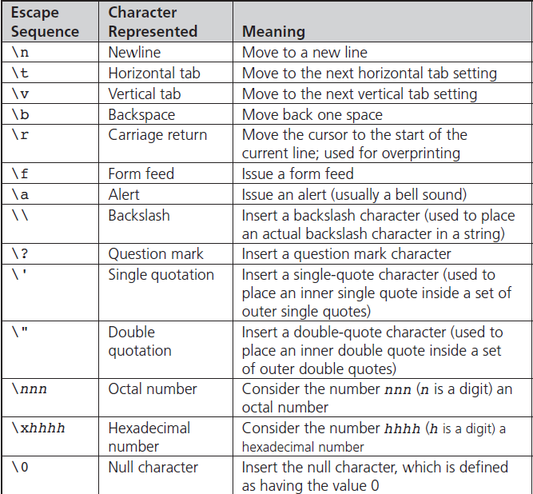
Escape Characters

Slide 10
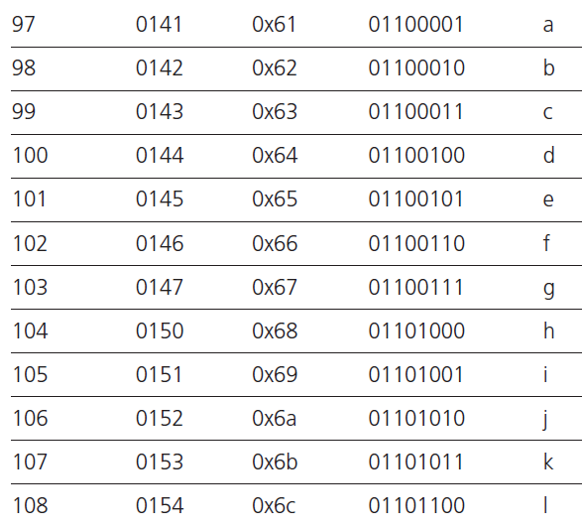
The ASCII Letter Codes

Slide 11
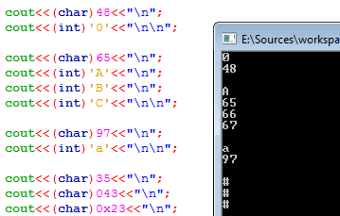
The ASCII Letter Codes

Slide 12
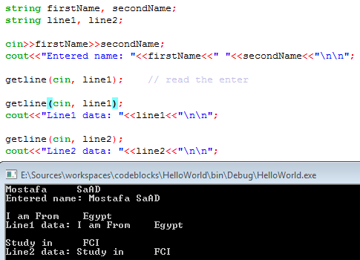
Reading strings

Slide 13
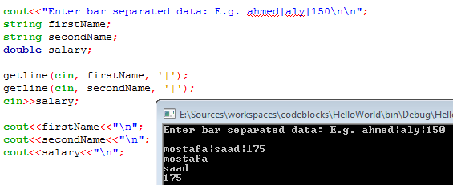
Reading strings

Slide 14
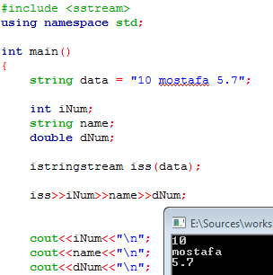
istringstream

Slide 15
Input Validaton
A popular problem is user gives unexpected input
E.g. User asked to give integer, he may
Enter integer -> good
Enter double -> corrupt remaining stream
Enter string -> corrupt all
An important issue is how to validate

Slide 16
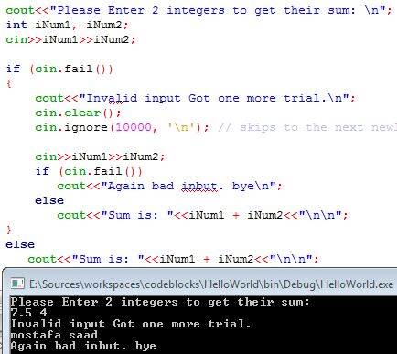
Input Validaton

Slide 17
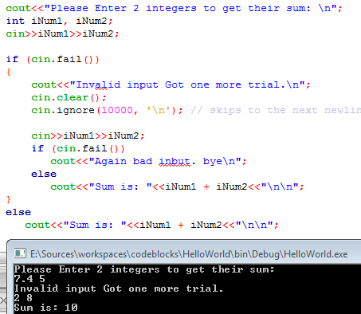
Input Validaton

Slide 18
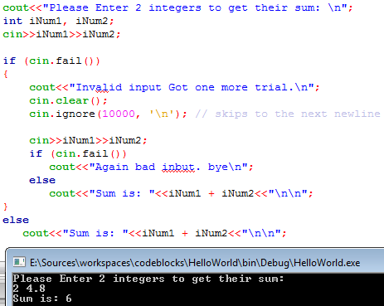
Input Validaton

Slide 19
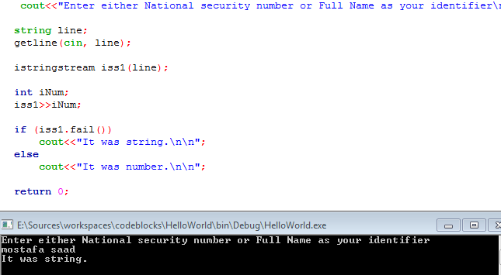
Input Validaton using istringstream

Slide 20
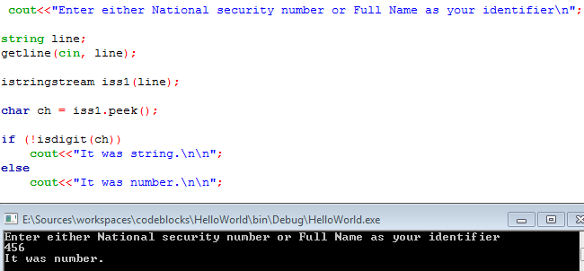
Smart trick = no validate

